Slide 1
Measures of central tendency
Mean - The mean of a sample or a population is computed by adding all of the observations and dividing by the number of observations.
Population mean = μ = ΣX / N
Sample mean = x = Σx / n
Median - To find the median, we arrange the observations in order from smallest to largest value. If there is an odd number of observations, the median is the middle value. If there is an even number of observations, the median is the average of the two middle values.
Mode – It is just the most frequently observed values

Slide 2
Quick exercise
Find the mean, median, mode, and range for the following list of values:
13, 18, 13, 14, 13, 16, 14, 21, 13
If your dataset has some missing values how will you approximate them? Mean or median?

Slide 3
The Mean vs. the Median
As measures of central tendency, the mean and the median each have advantages and disadvantages. Some pros and cons of each measure are summarized below.
The median may be a better indicator of the most typical value if a set of scores has an outlier. An outlier is an extreme value that differs greatly from other values.
However, when the sample size is large and does not include outliers, the mean score usually provides a better measure of central tendency.

Slide 4
Measures of variability
Statisticians use summary measures to describe the amount of variability or spread in a set of data. The most common measures of variability are the range, the interquartile range (IQR), variance, and standard deviation.
Range
The range is the difference between the largest and smallest values in a set of values.
For example, consider the following numbers: 1, 3, 4, 5, 5, 6, 7, 11. For this set of numbers, the range would be 11 - 1 or 10.
Interquartile Range (IQR)
The interquartile range (IQR) is a measure of variability, based on dividing a data set into quartiles.
Quartiles divide a rank-ordered data set into four equal parts. The values that divide each part are called the first, second, and third quartiles; and they are denoted by Q1, Q2, and Q3, respectively.

Slide 5
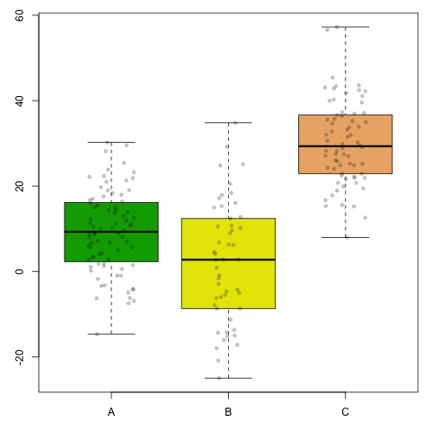
IQR Continued
Q1 is the "middle" value in the first half of the rank-ordered data set.
Q2 is the median value in the set.
Q3 is the "middle" value in the second half of the rank-ordered data set.
The interquartile range is equal to Q3 minus Q1

Slide 6
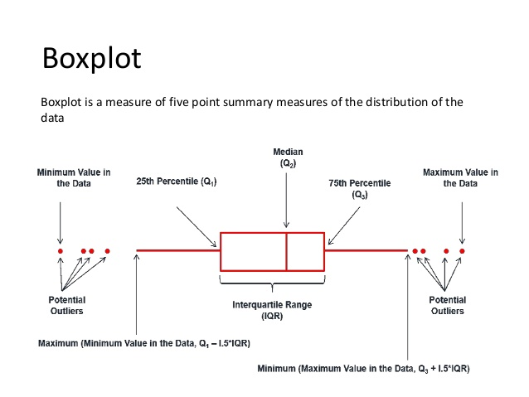

Slide 7
Variance
In a population, variance is the average squared deviation from the population mean, as defined by the following formula:
σ² = Σ ( X_{i} - μ )² / N
where σ² is the population variance, μ is the population mean, X_{i} is the ith element from the population, and N is the number of elements in the population.
Observations from a simple random sample can be used to estimate the variance of a population. For this purpose, sample variance is defined by slightly different formula, and uses a slightly different notation:
s² = Σ ( x_{i} - x )² / ( n – 1 )
where s² is the sample variance, x is the sample mean, x_{i} is the ith element from the sample, and n is the number of elements in the sample.

Slide 8
Standard deviation
The standard deviation is the square root of the variance. Thus, the standard deviation of a population is:
σ = sqrt [ σ² ] = sqrt [ Σ ( X_{i} - μ )² / N ]
where σ is the population standard deviation, μ is the population mean, X_{i} is the ith element from the population, and N is the number of elements in the population.
Statisticians often use simple random samples to estimate the standard deviation of a population, based on sample data. Given a simple random sample, the best estimate of the standard deviation of a population is:
s = sqrt [ s² ] = sqrt [ Σ ( x_{i} - x )² / ( n - 1 ) ]
where s is the sample standard deviation, x is the sample mean, x_{i} is the ith element from the sample, and n is the number of elements in the sample.

Slide 9
Test your understanding
A simple random sample consists of four observations: {1, 3, 5, 7}. Based on these sample observations, what is the best estimate of the standard deviation of the population?
(A) 2 (B) 2.58 (C) 6 (D) 6.67 (E) None of the above

Slide 10
solution
The correct answer is (B). First, we need to compute the sample mean.
x = Σx / n = ( 1 + 3 + 5 + 7 ) / 4 = 4
Then we plug all of the known values into formula for the standard deviation of a sample, as shown below:
s = sqrt [ Σ ( x_{i} - x )² / ( n - 1 ) ] s = sqrt { [ ( 1 - 4 )² + ( 3 - 4 )² + ( 5 - 4 )² + ( 7 - 4 )² ] / ( 4 - 1 ) } s = sqrt { [ ( -3 )² + ( -1 )² + ( 1 )² + ( 3 )² ] / 3 } s = sqrt { [ 9 + 1 + 1 + 9 ] / 3 } = sqrt (20 / 3) = sqrt ( 6.67 ) = 2.58
Note: This problem asked us to estimate the standard deviation of a population, based on sample data. To do this, we used (n - 1) in the denominator of the standard deviation formula. If the problem had asked us to compute the standard deviation of a population based on population data, we would have used N in the denominator.

Slide 11
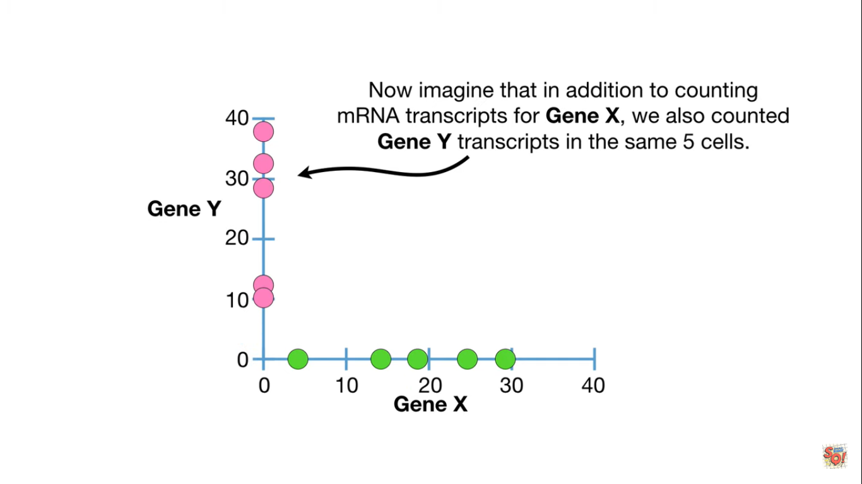

Slide 12
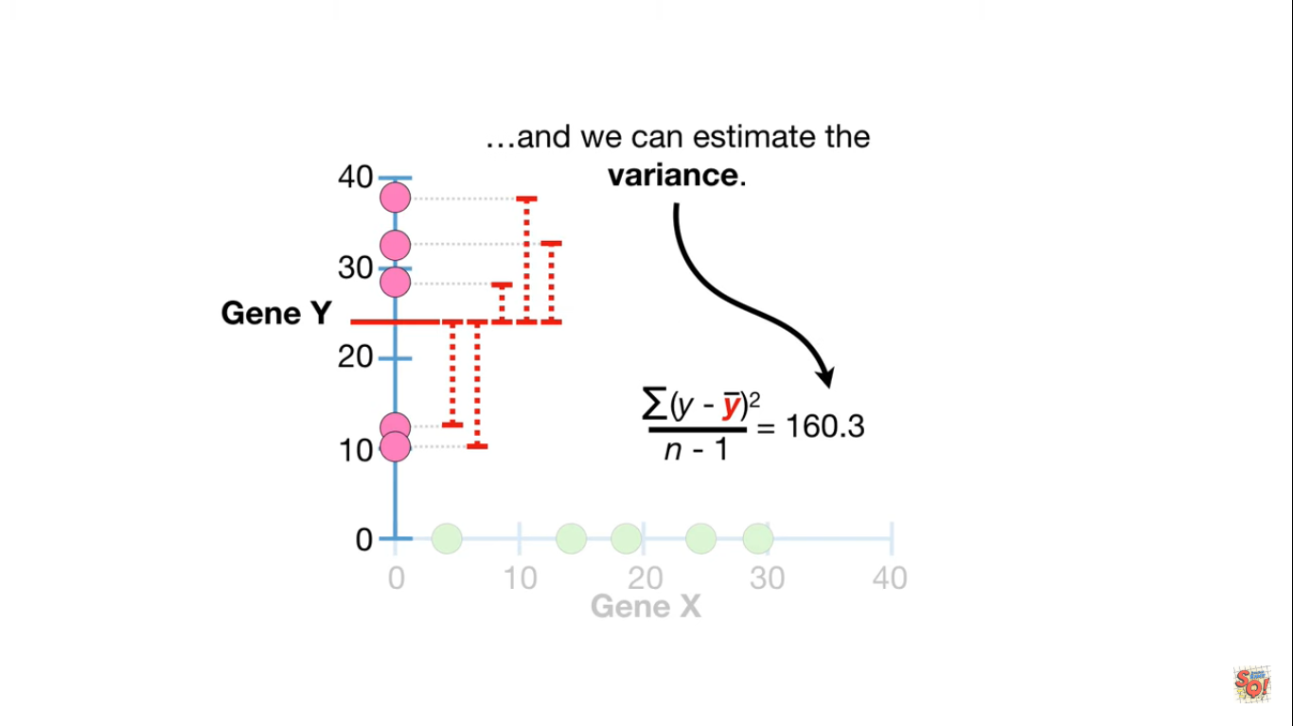

Slide 13
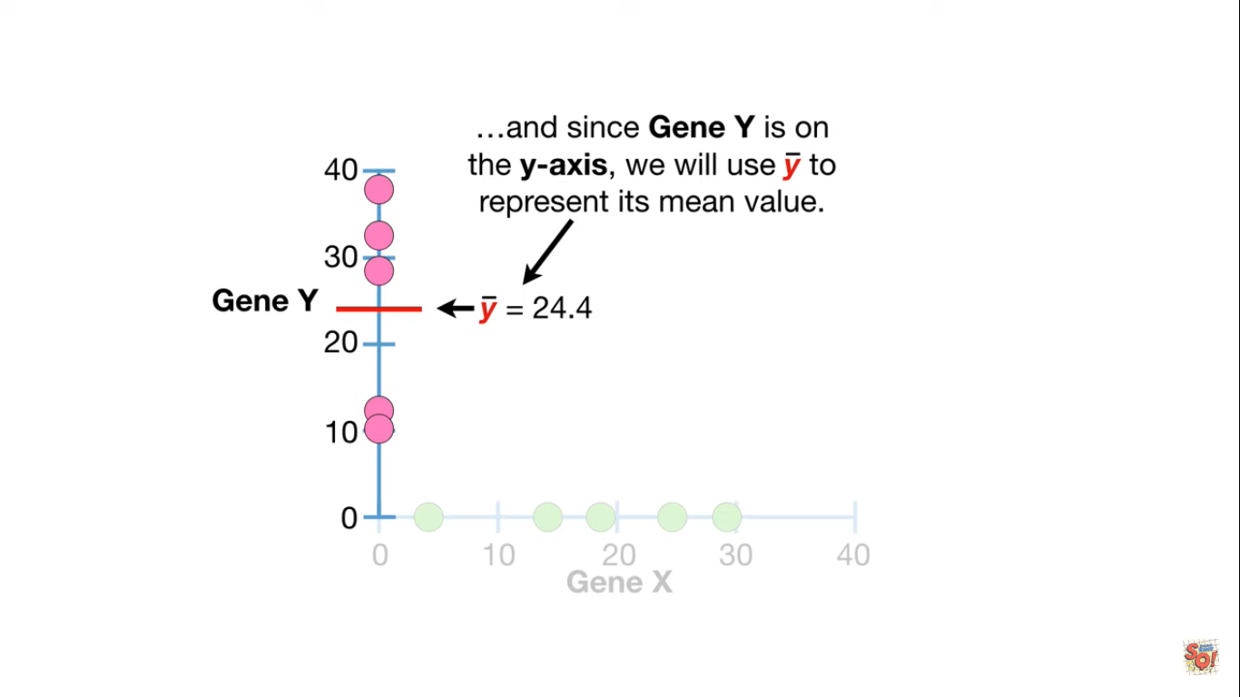
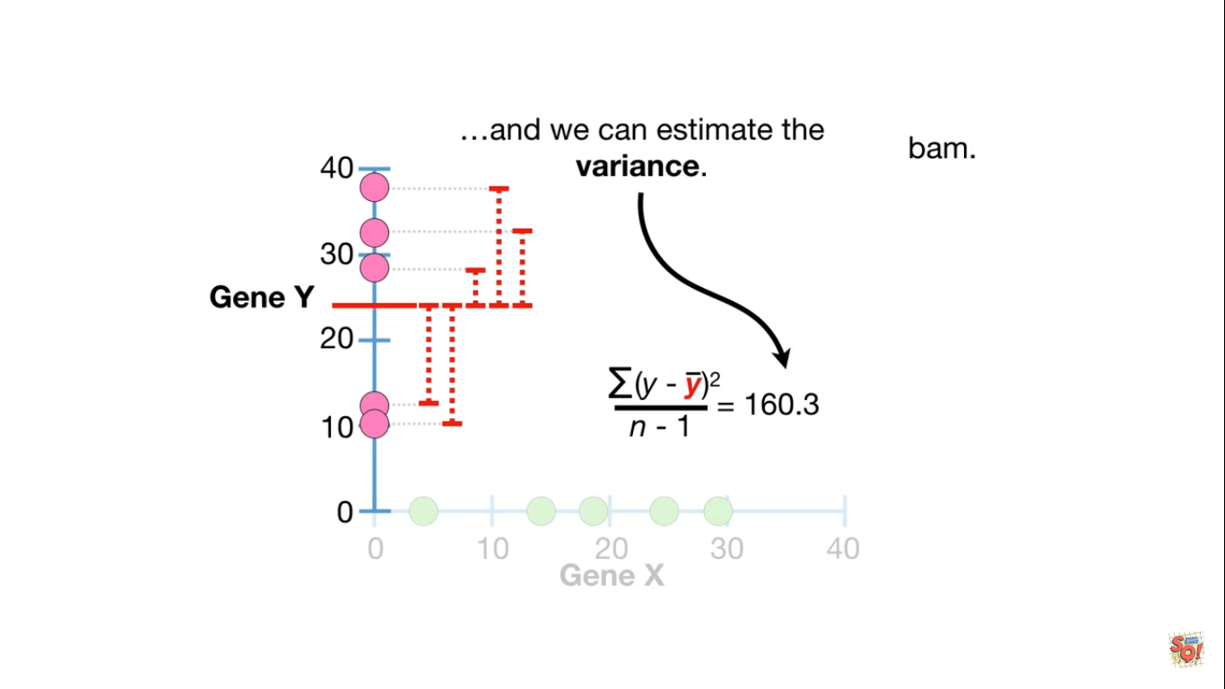
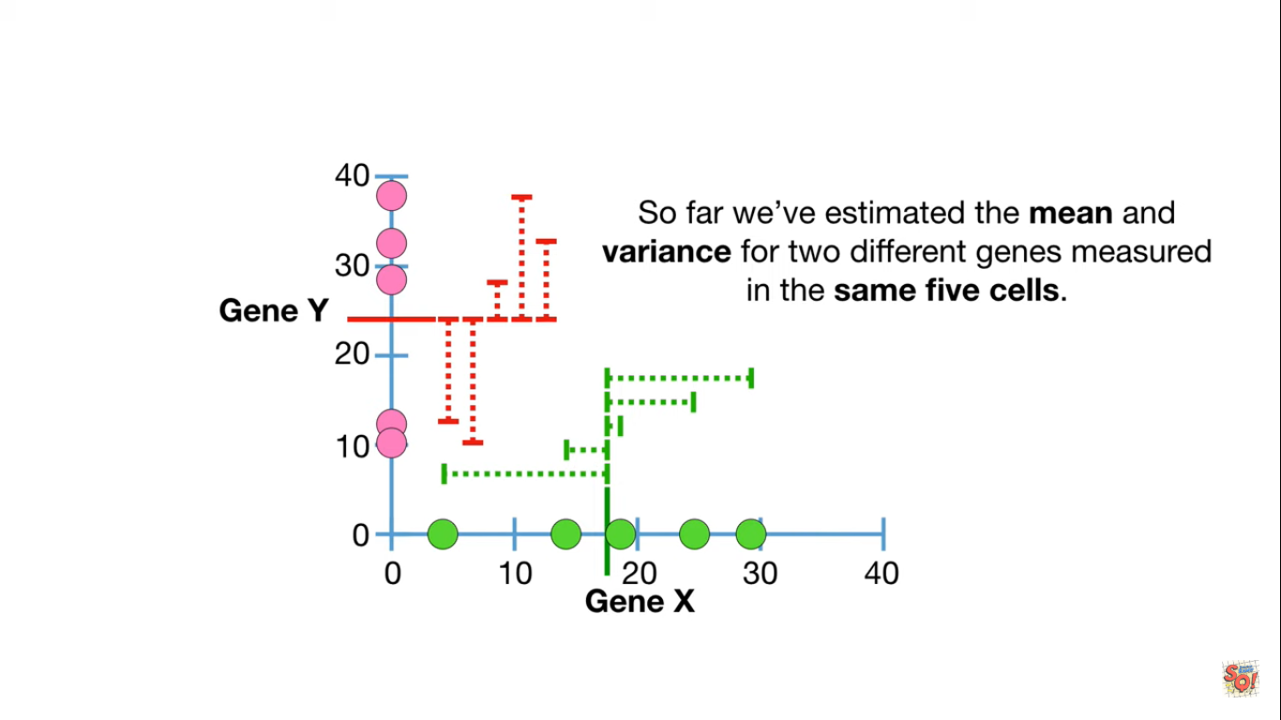

Slide 14
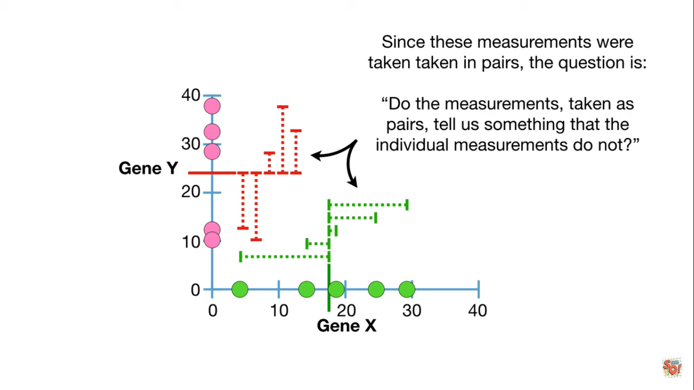

Slide 15
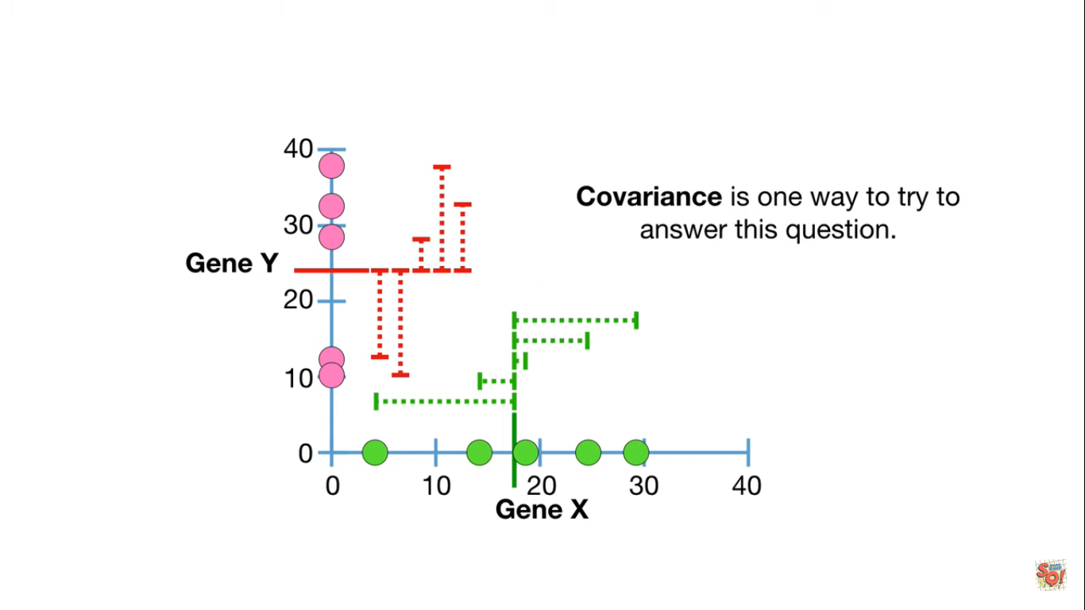

Slide 16
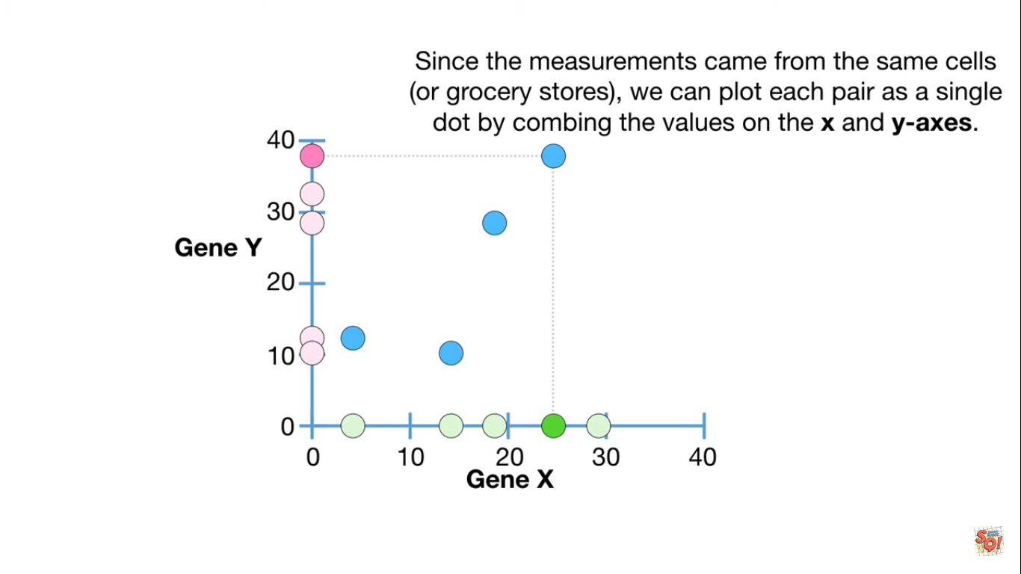

Slide 17
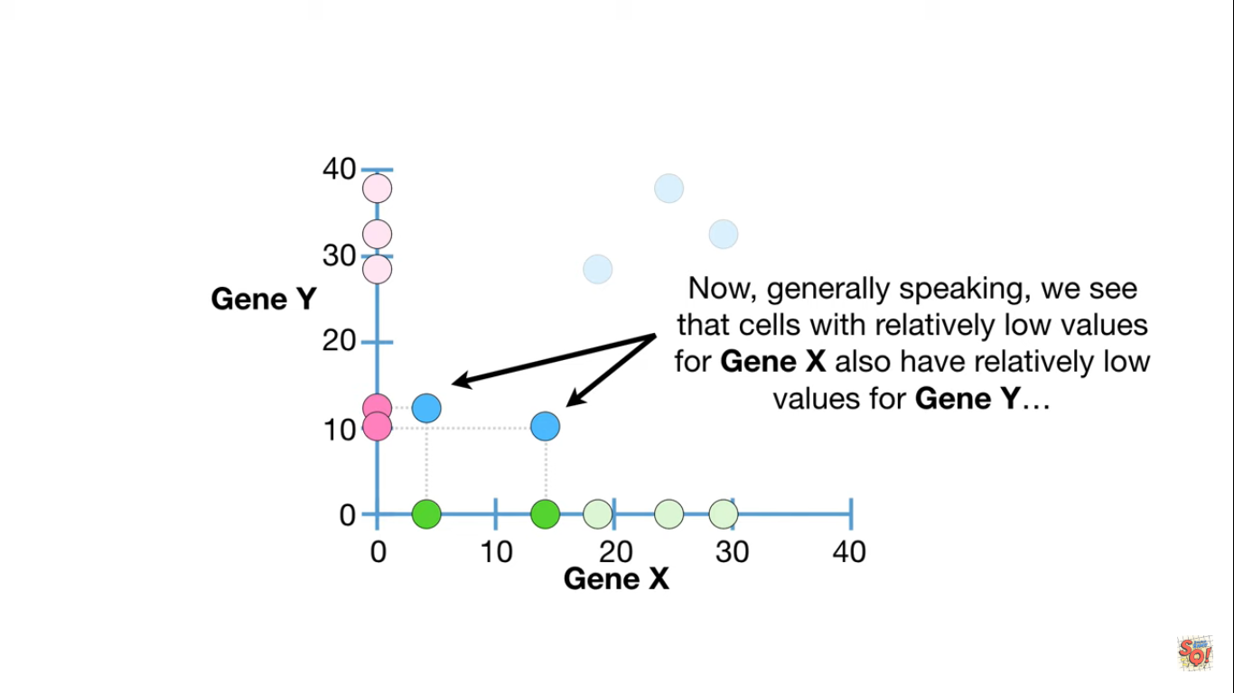

Slide 18
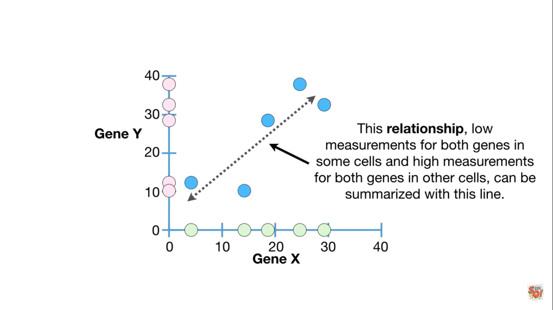

Slide 19
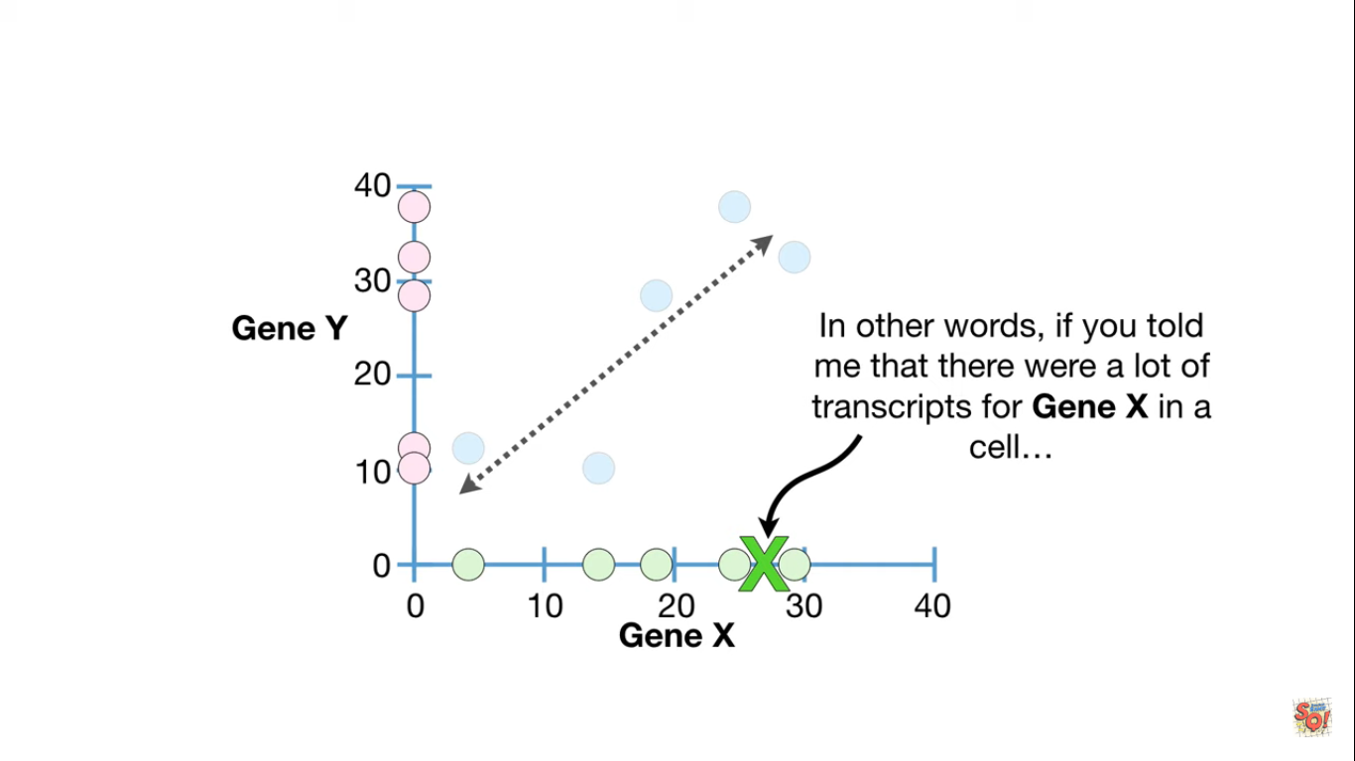

Slide 20
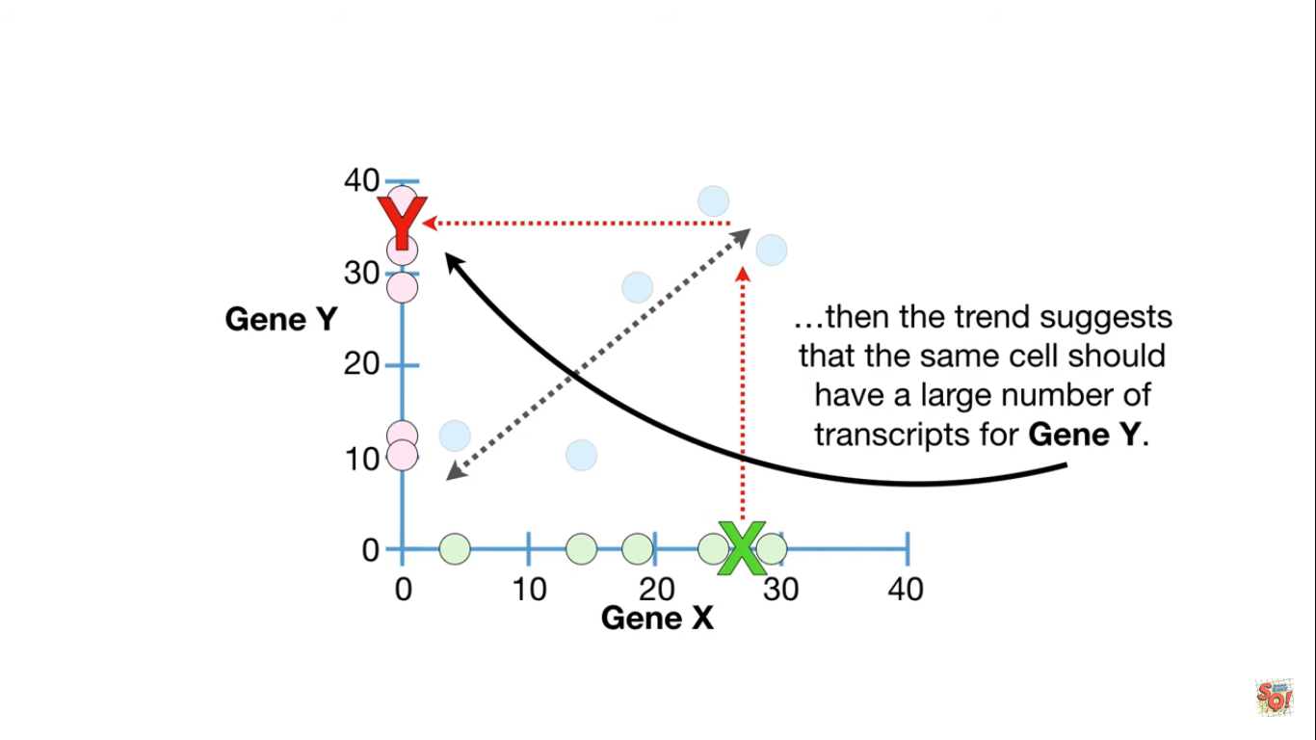

Slide 21
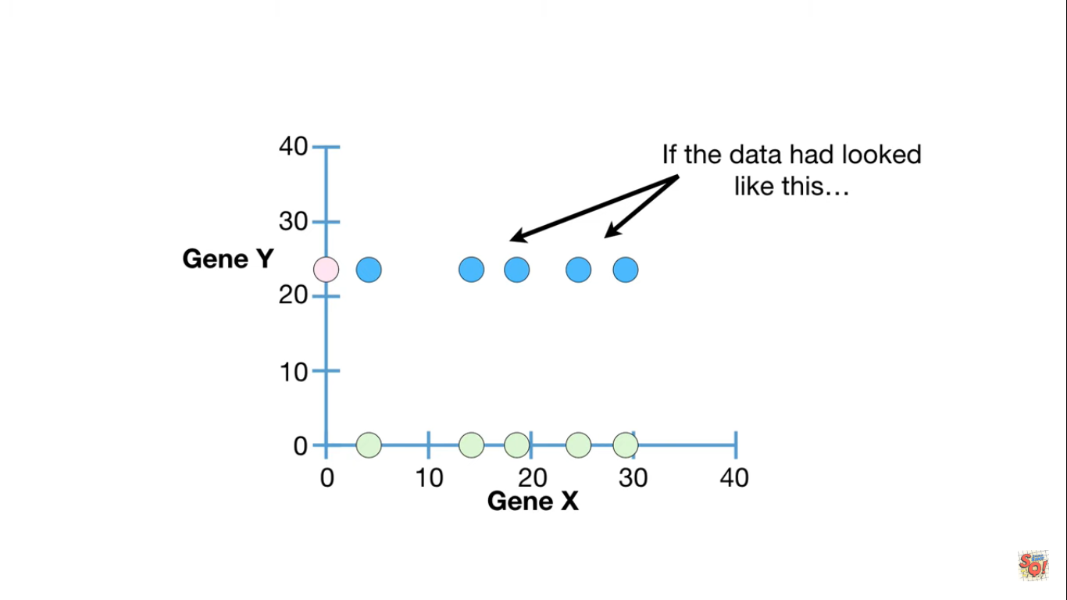

Slide 22
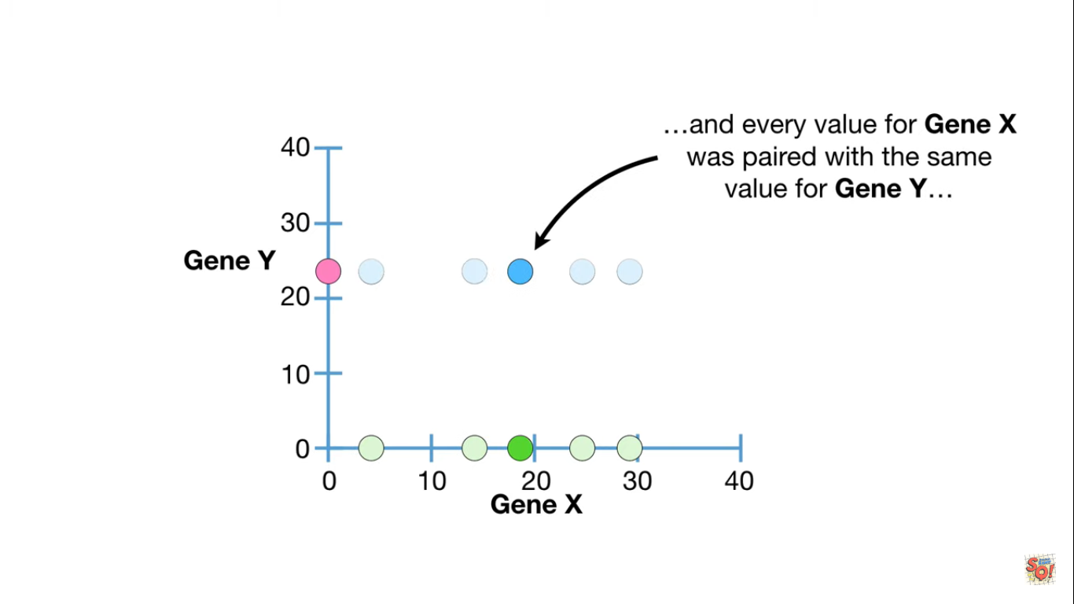

Slide 23
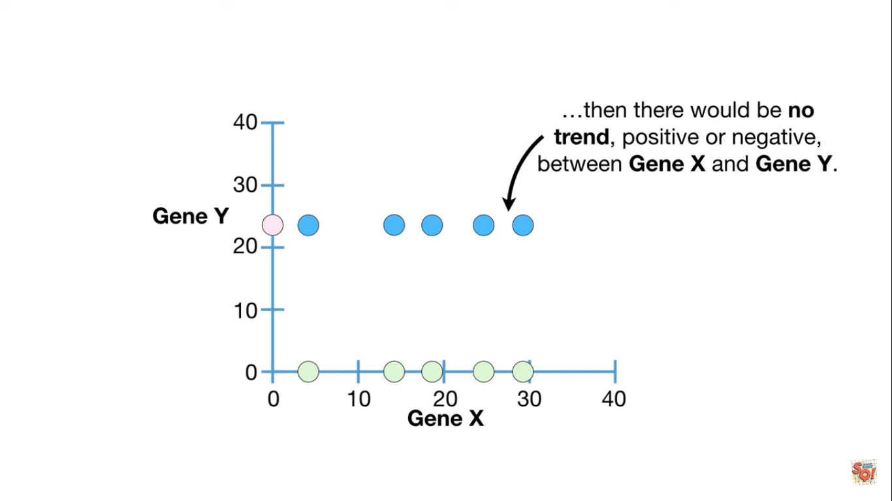

Slide 24
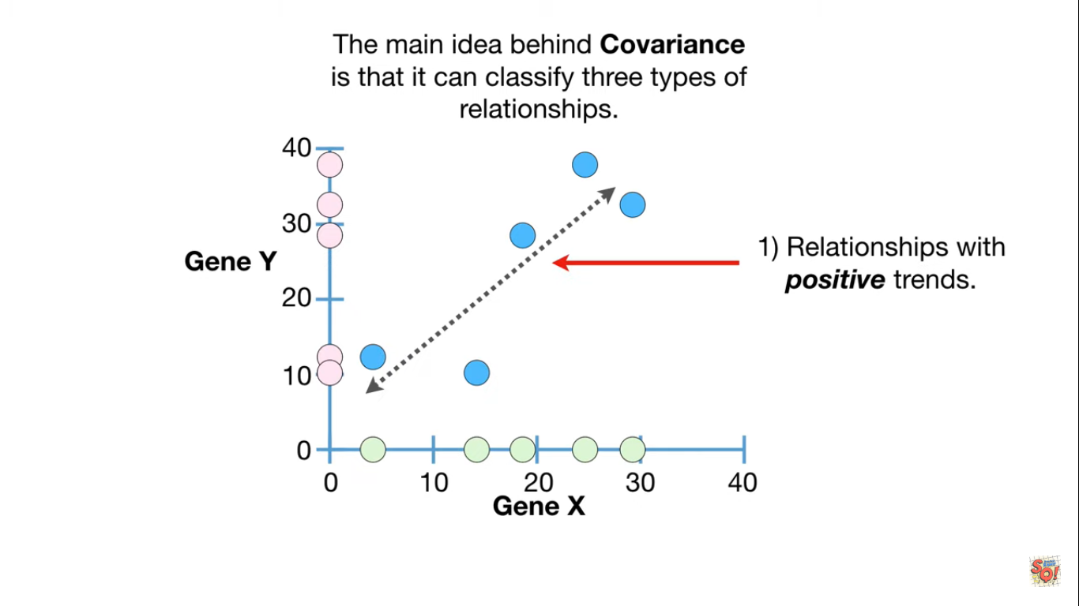

Slide 25
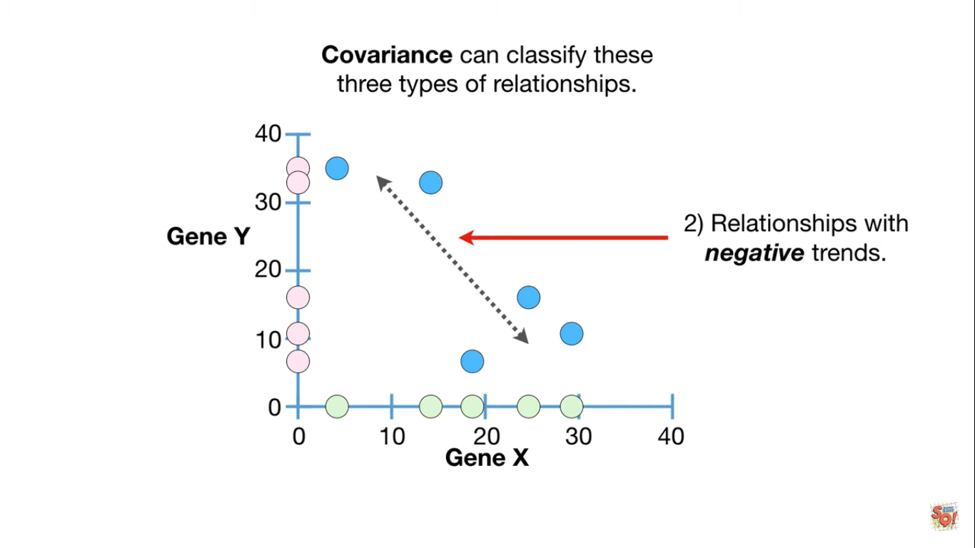

Slide 26
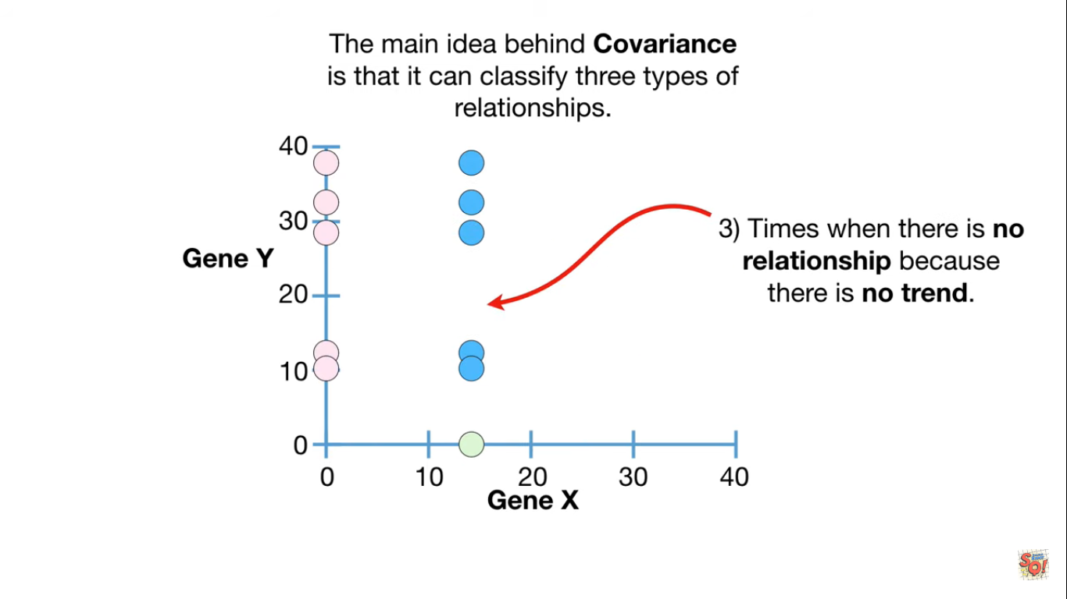

Slide 27
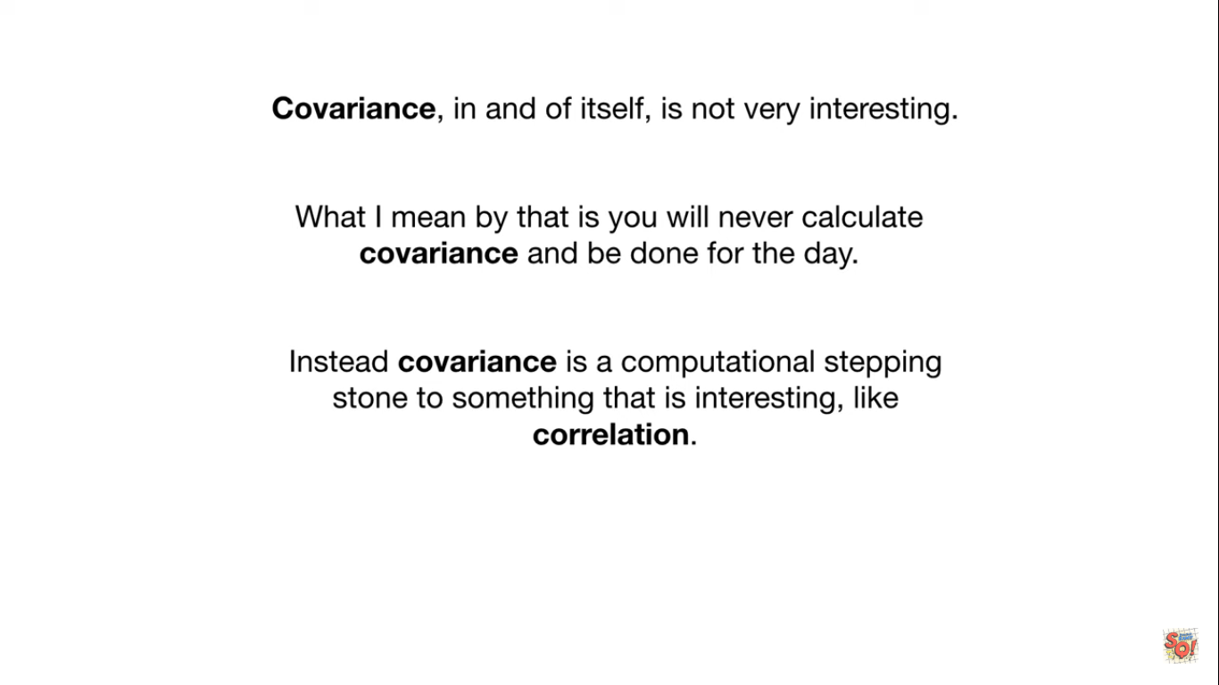

Slide 28
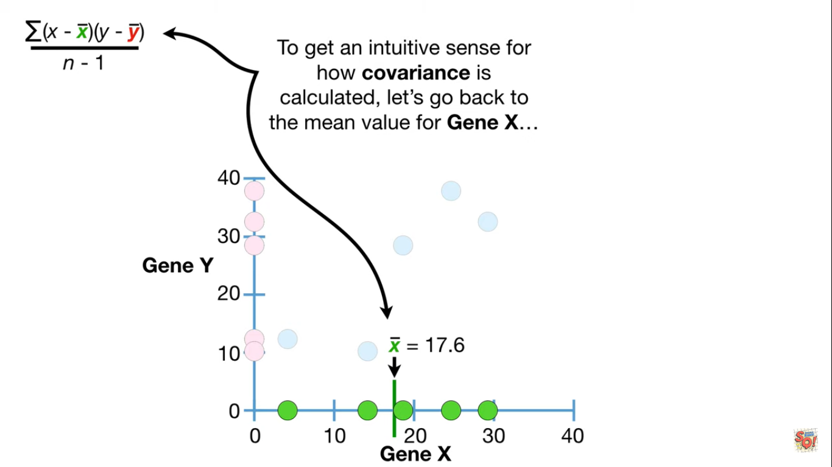

Slide 29
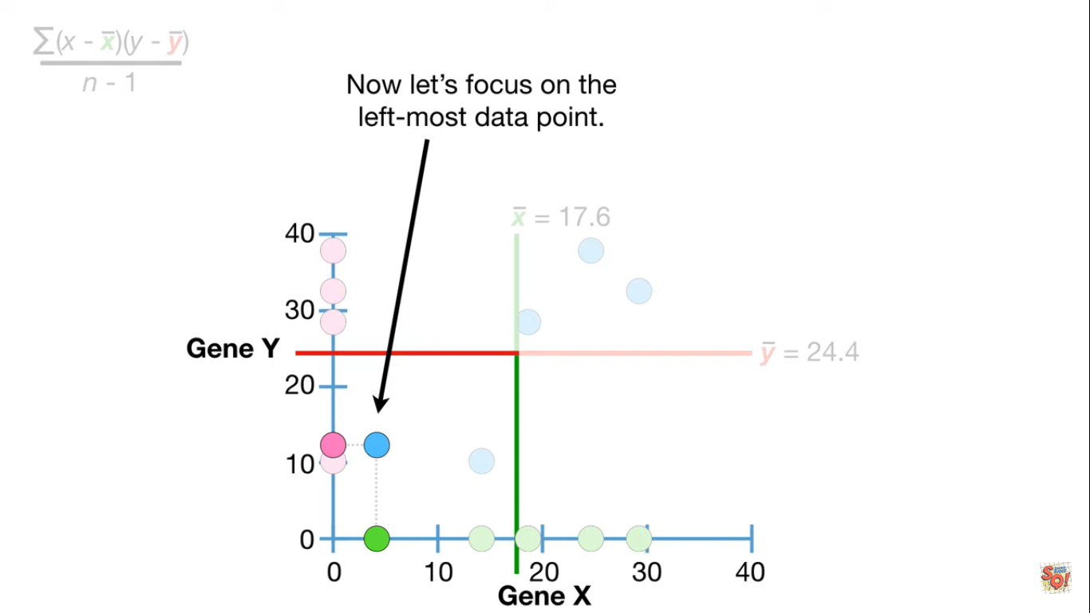

Slide 30
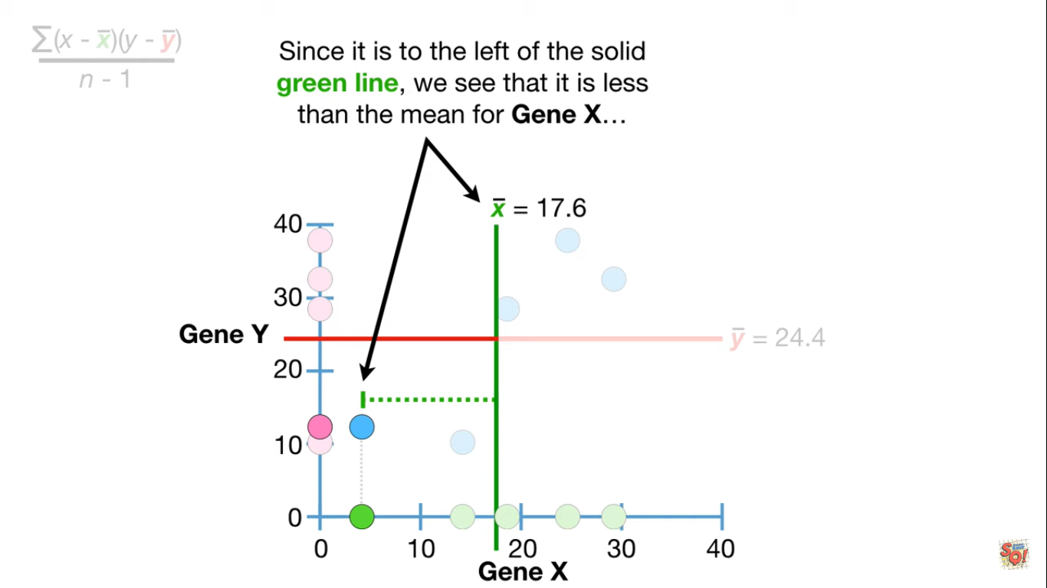

Slide 31
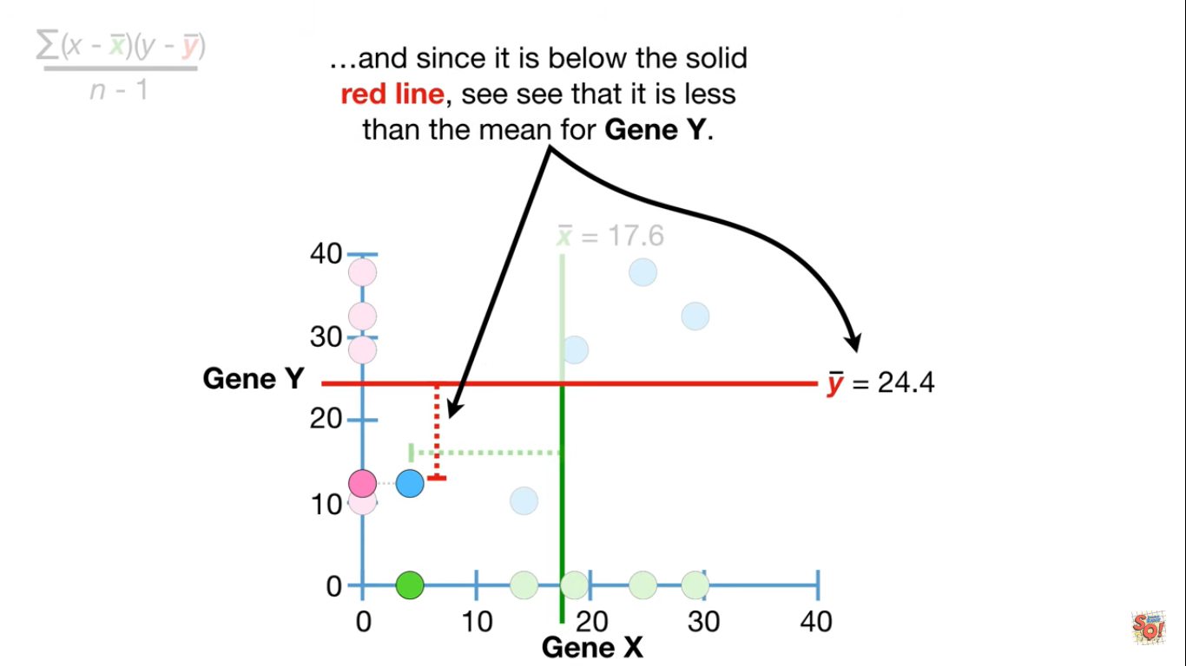

Slide 32
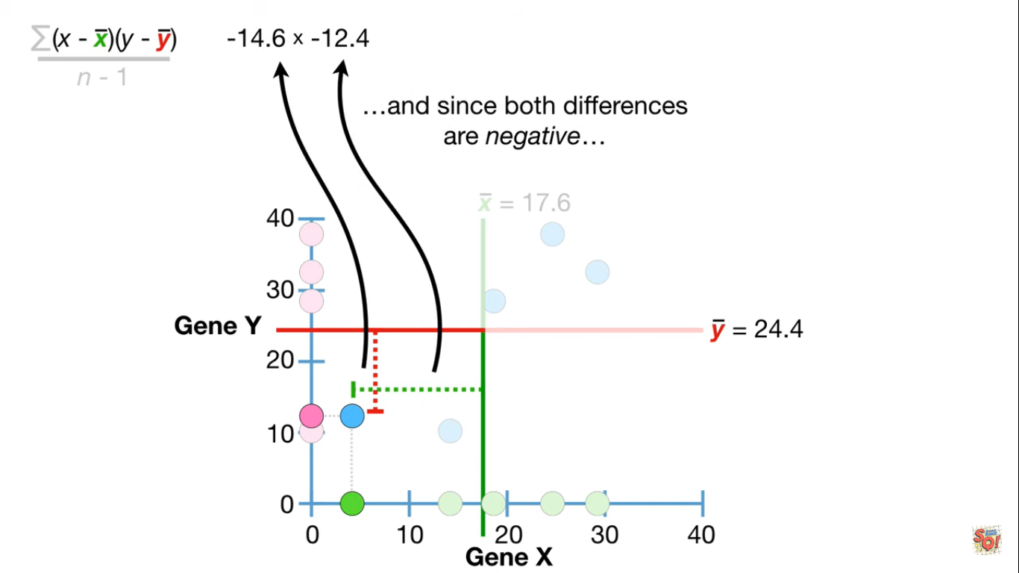

Slide 33
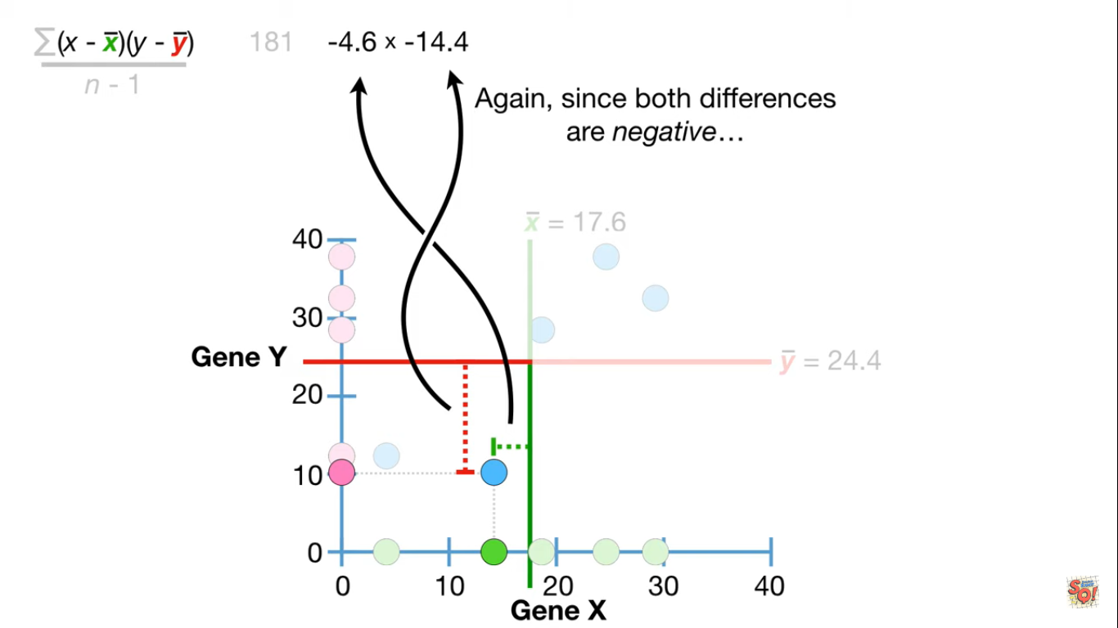

Slide 34
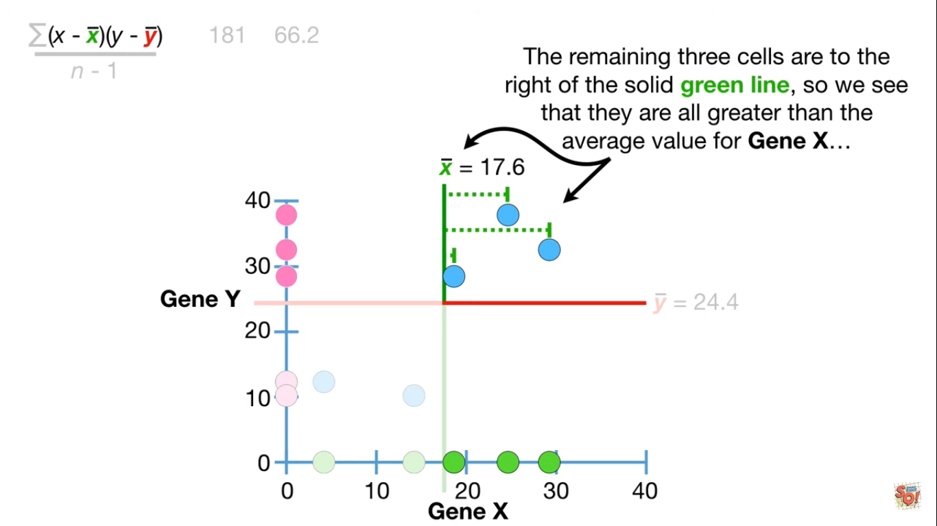

Slide 35
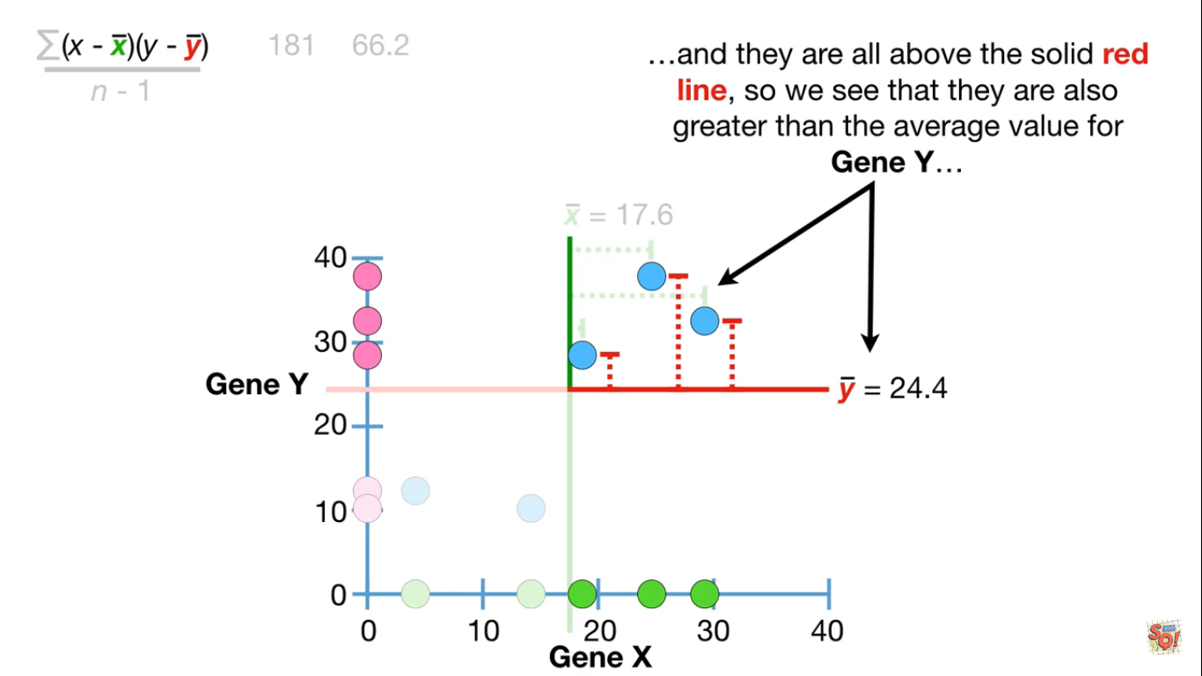

Slide 36
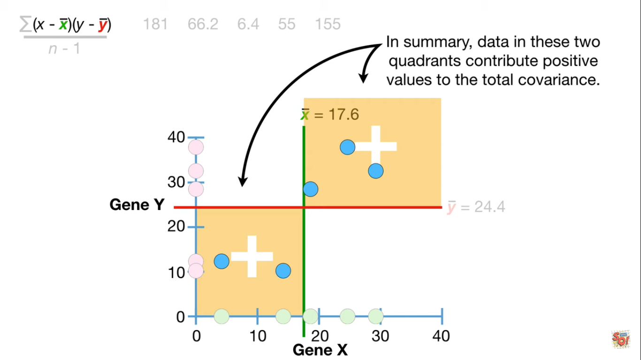

Slide 37
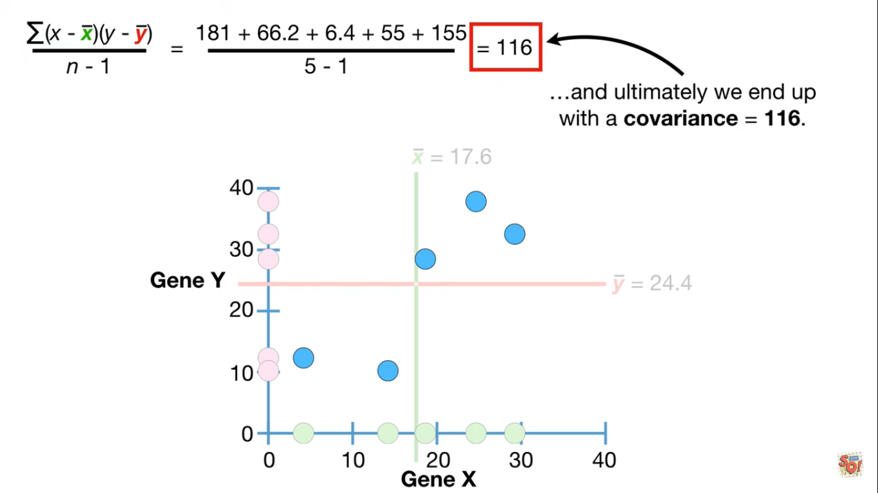

Slide 38
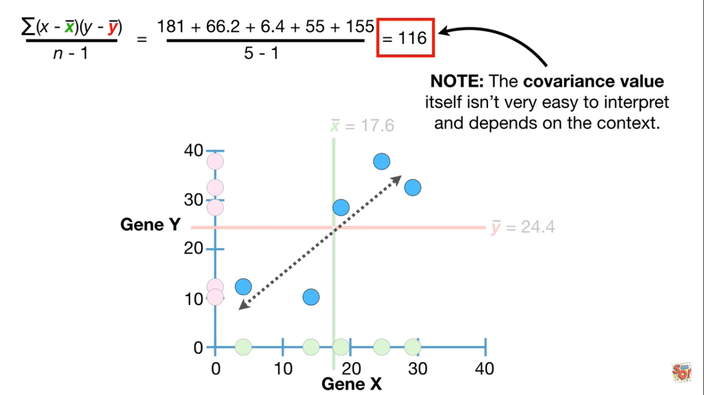

Slide 39
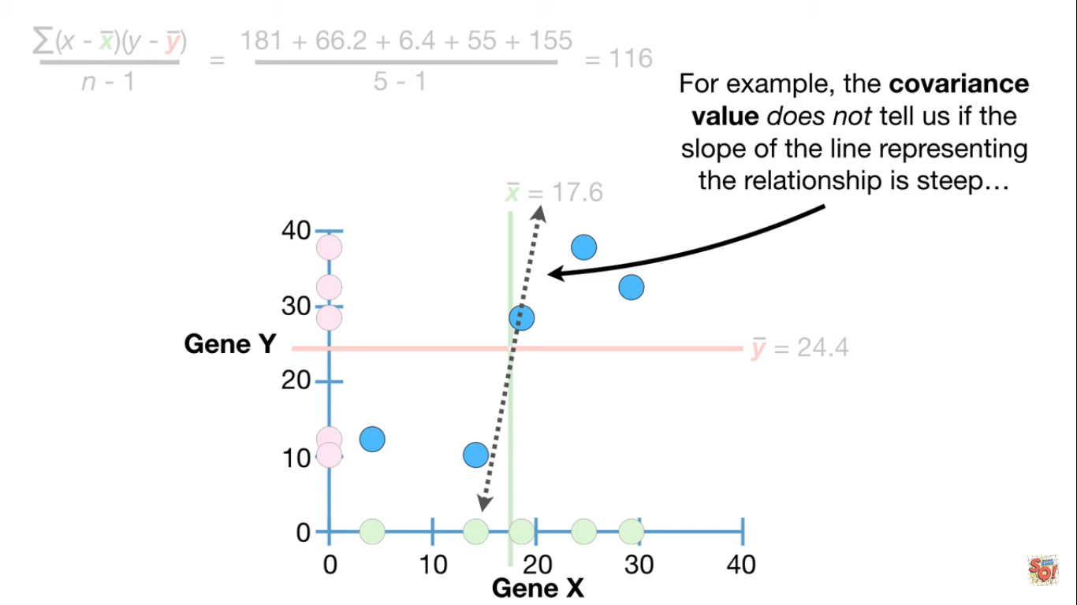

Slide 40
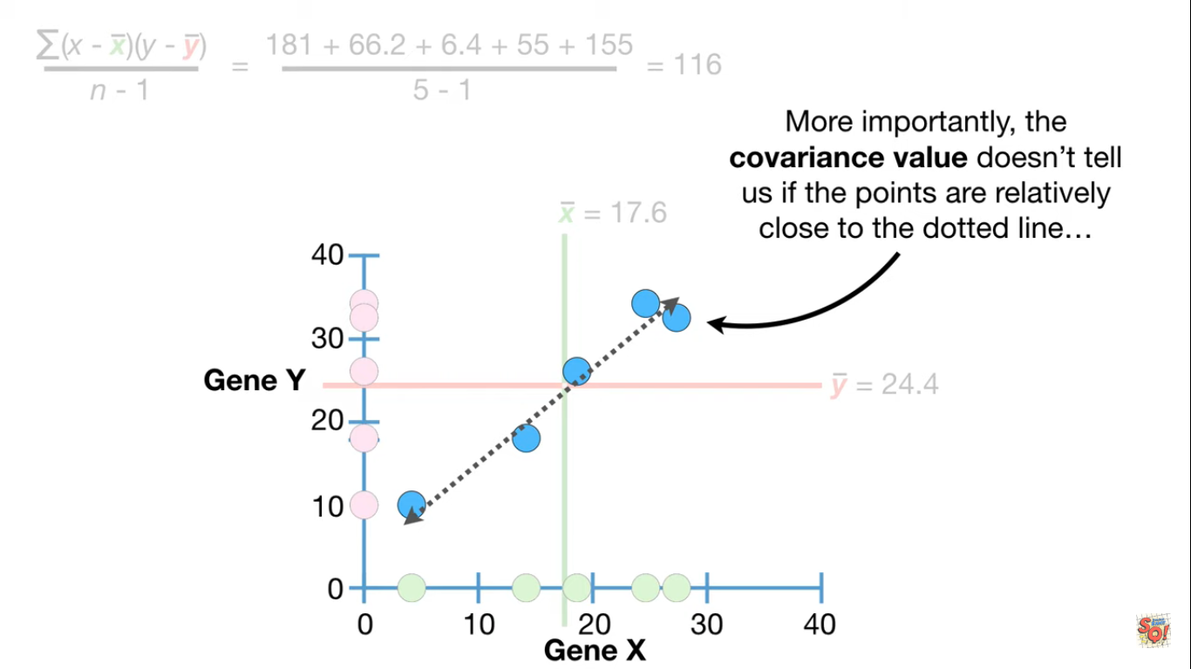

Slide 41
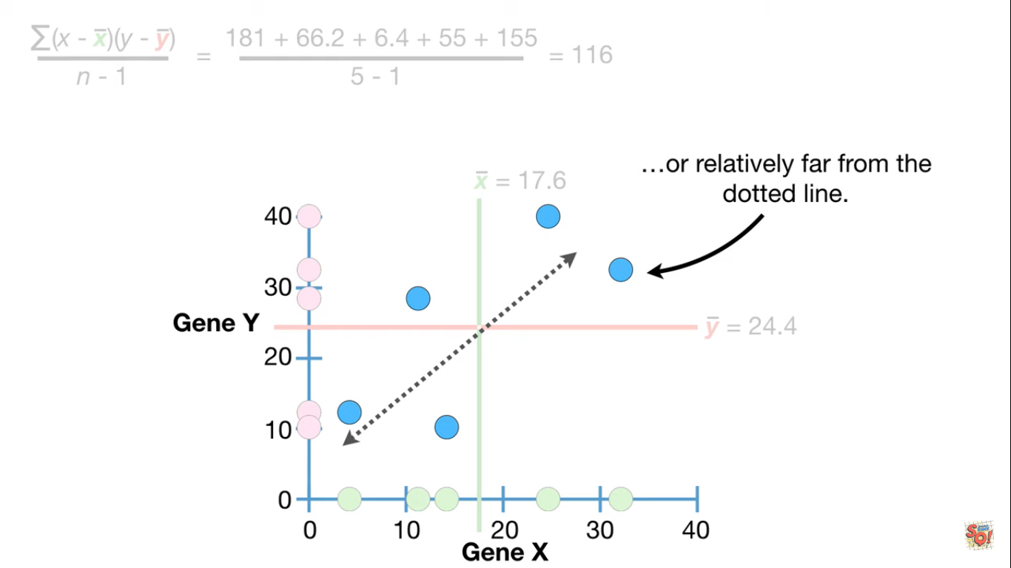

Slide 42
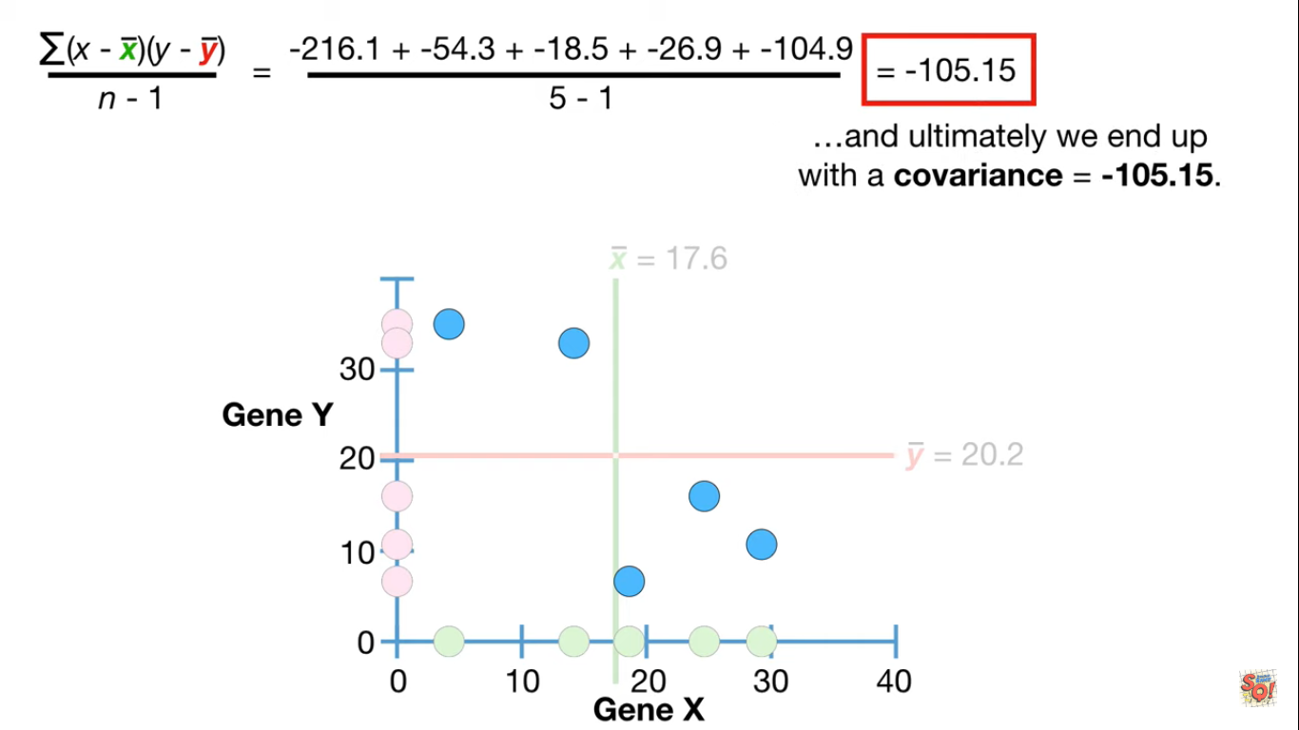

Slide 43
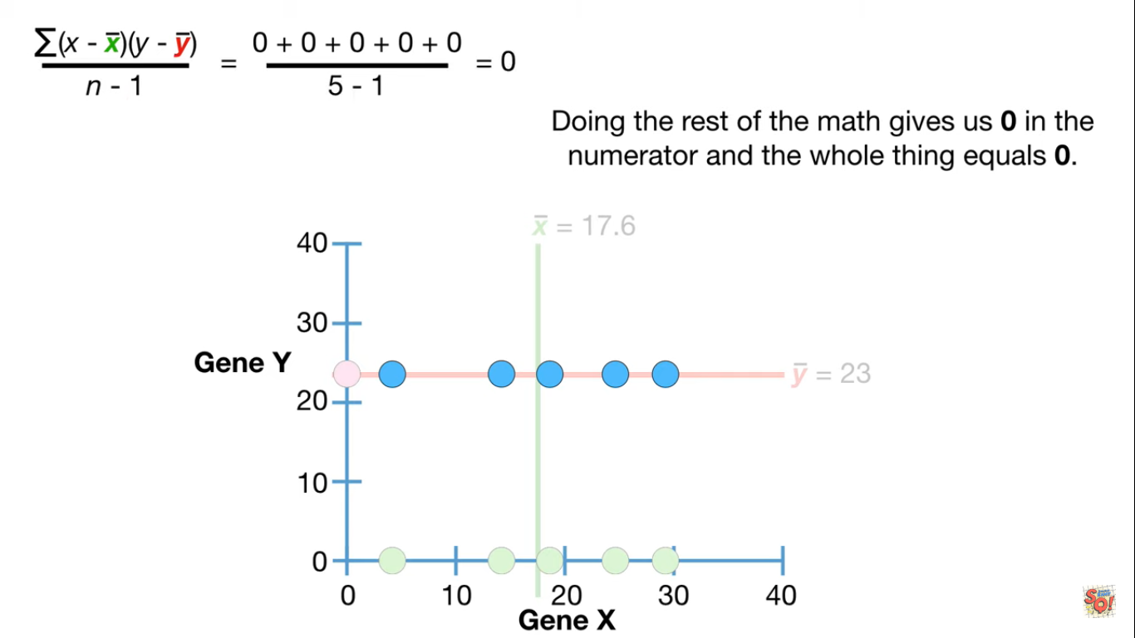

Slide 44
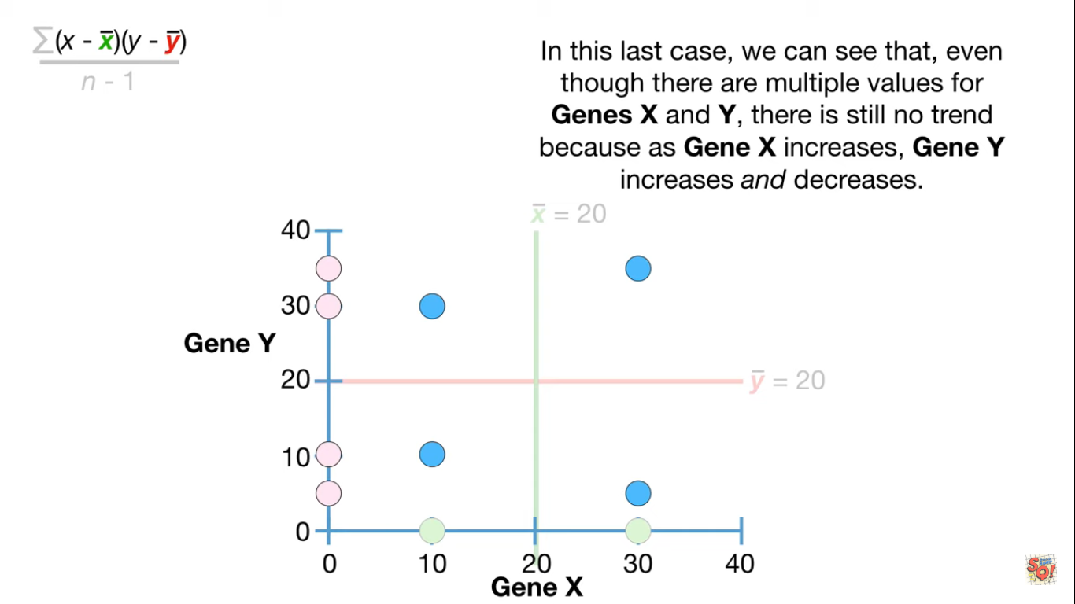

Slide 45
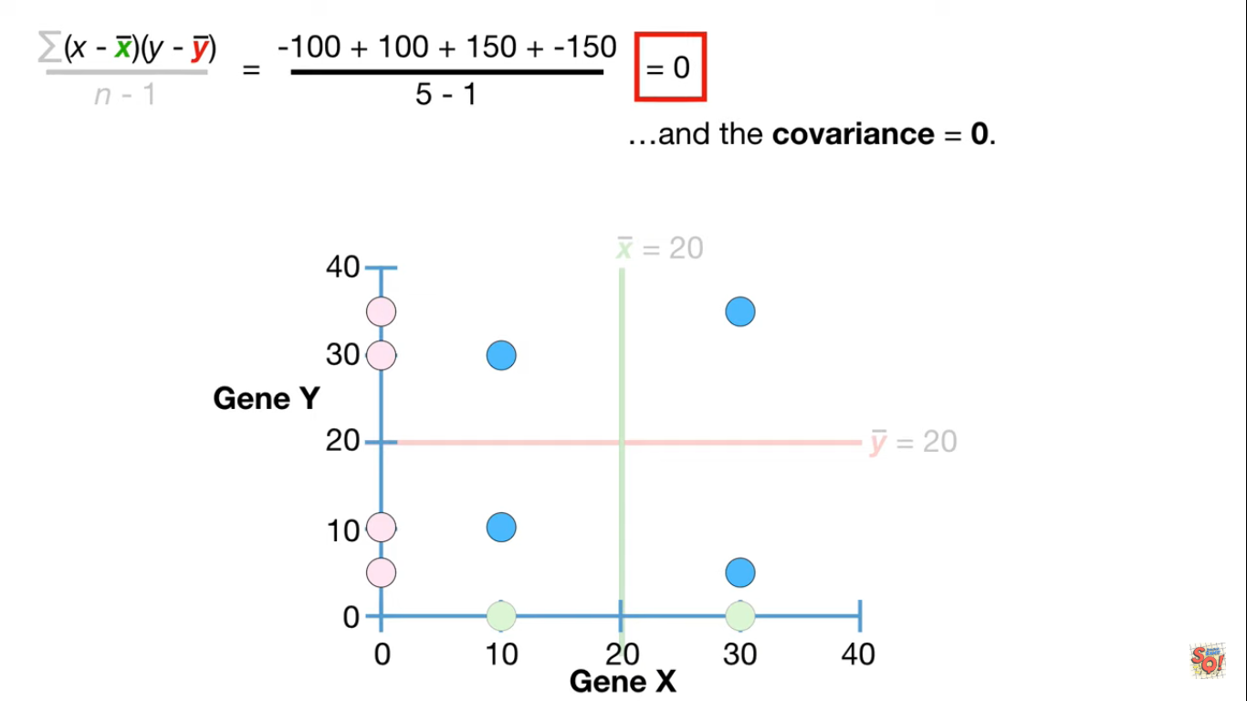

Slide 46
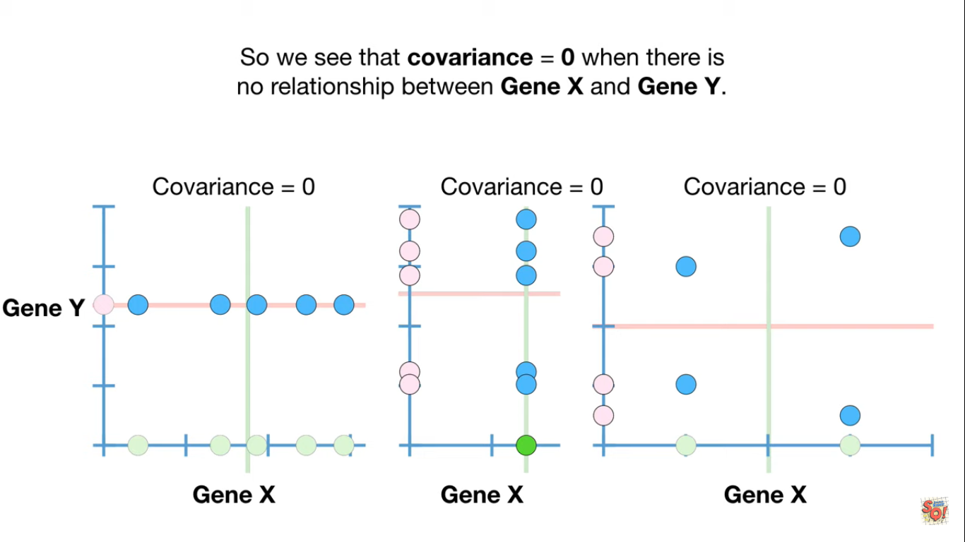

Slide 47
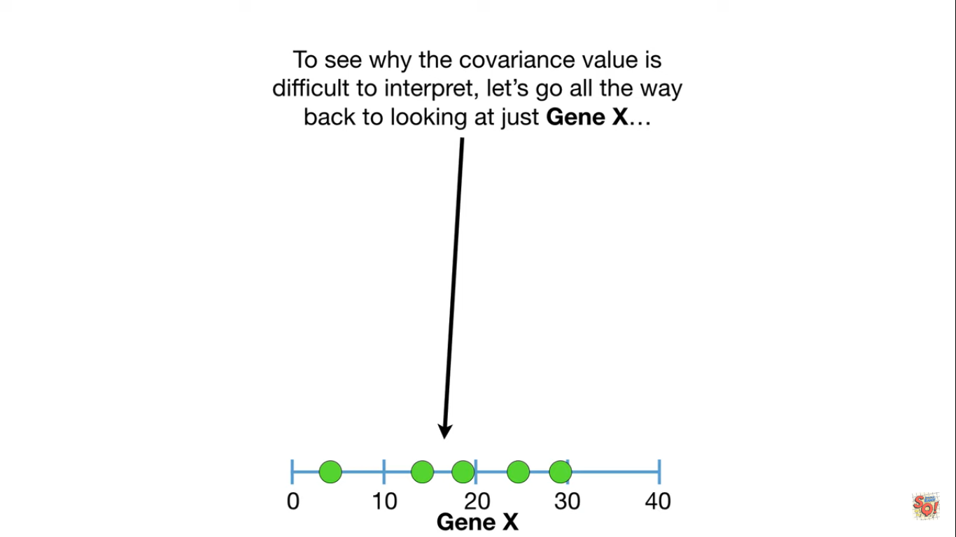

Slide 48
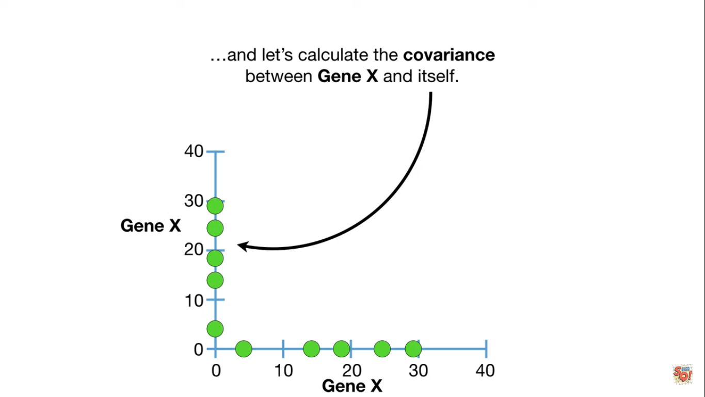

Slide 49
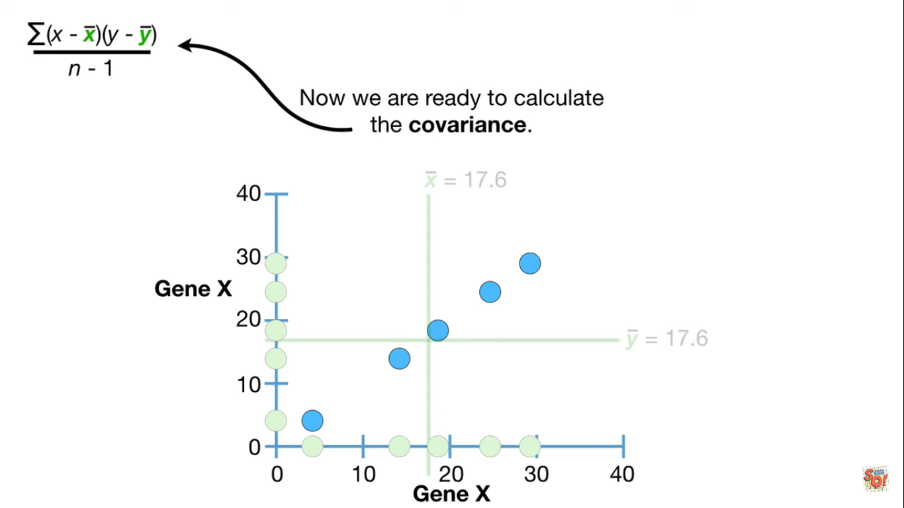

Slide 50
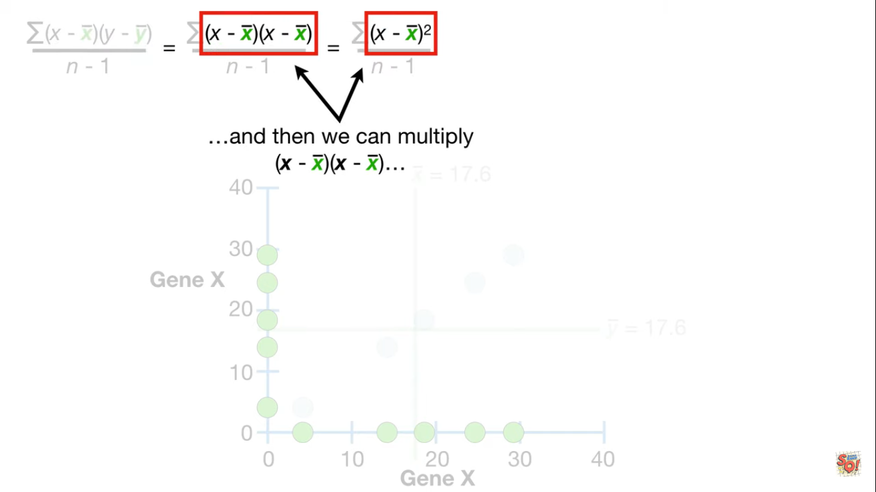

Slide 51
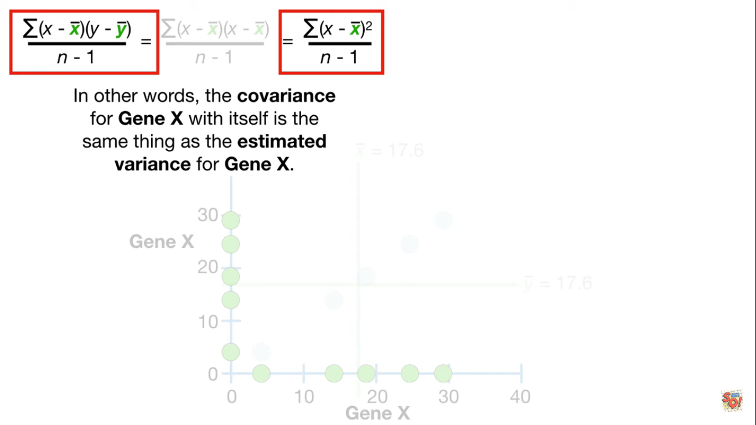

Slide 52
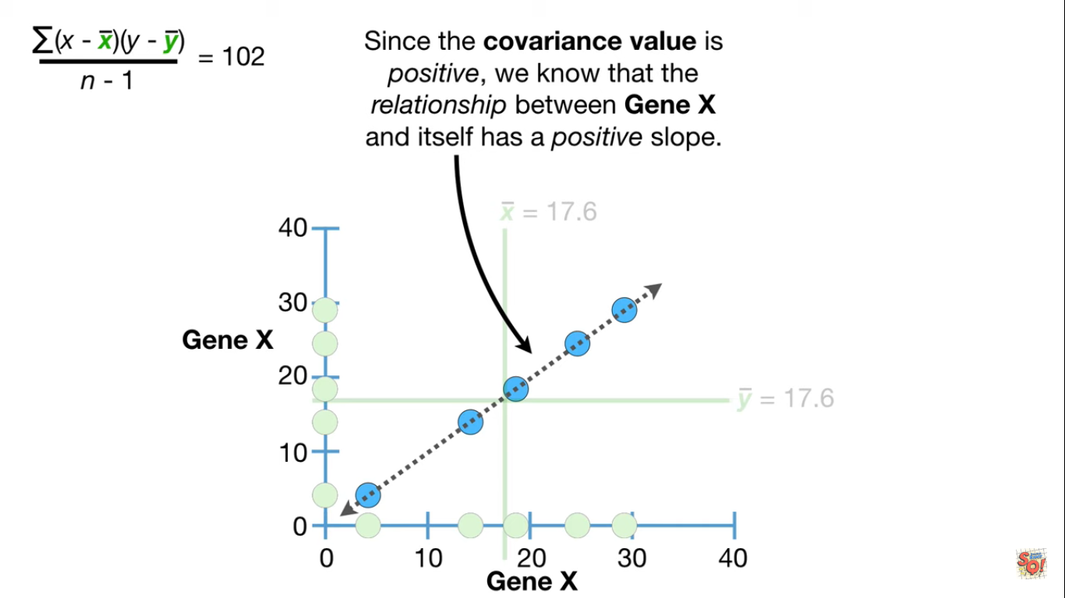

Slide 53
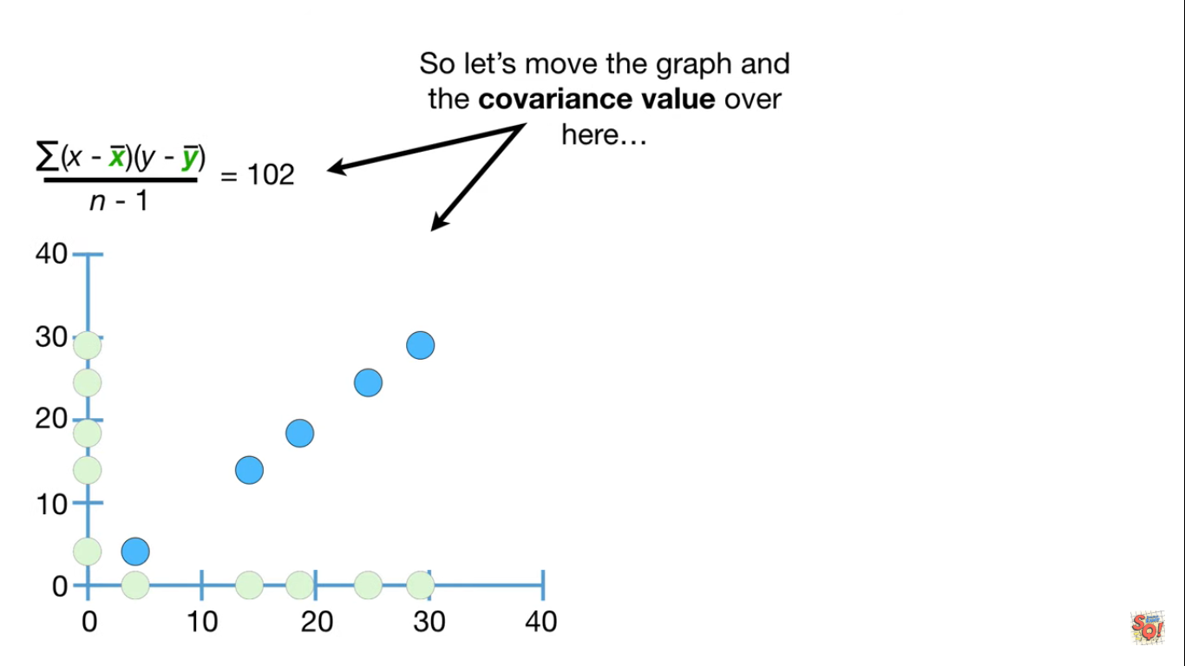

Slide 54
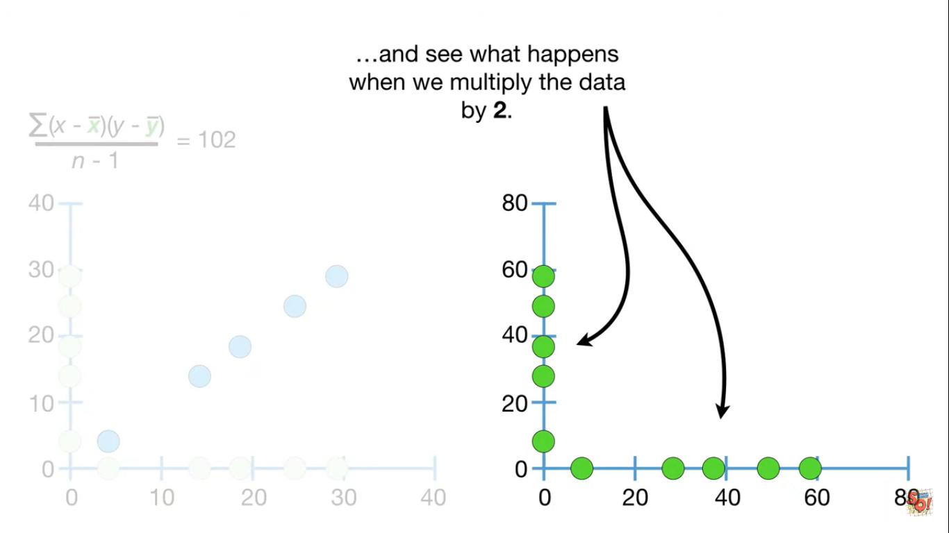

Slide 55
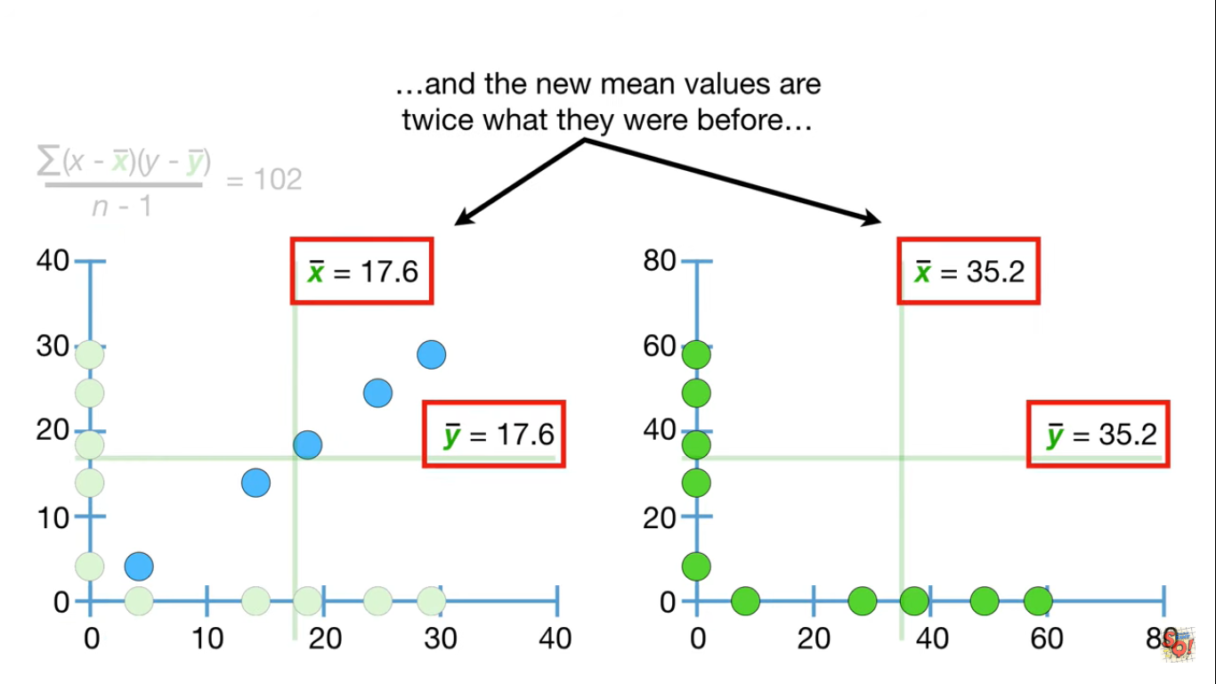

Slide 56
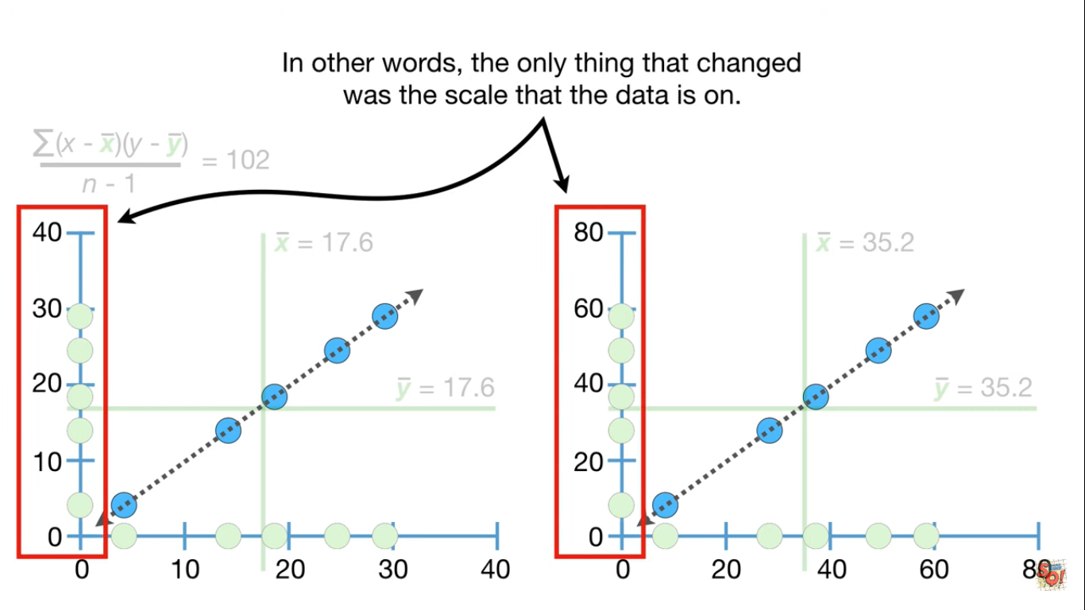

Slide 57


Slide 58


Slide 59


Slide 60


Slide 61


Slide 62


Slide 63


Slide 64


Slide 65


Slide 66


Slide 67


Slide 68


Slide 69


Slide 70


Slide 71


Slide 72


Slide 73


Slide 74


Slide 75


Slide 76


Slide 77


Slide 78


Slide 80


Slide 81


Slide 82
Test your understanding
A national consumer magazine reported the following correlations.
The correlation between car weight and car reliability is -0.30.
The correlation between car weight and annual maintenance cost is 0.20.
Which of the following statements are true?
I. Heavier cars tend to be less reliable. II. Heavier cars tend to cost more to maintain. III. Car weight is related more strongly to reliability than to maintenance cost.
(A) I only (B) II only (C) III only (D) I and II only (E) I, II, and III

Slide 83
solution
The correct answer is (E). The correlation between car weight and reliability is negative. This means that reliability tends to decrease as car weight increases. The correlation between car weight and maintenance cost is positive. This means that maintenance costs tend to increase as car weight increases.
The strength of a relationship between two variables is indicated by the absolute value of the correlation coefficient. The correlation between car weight and reliability has an absolute value of 0.30. The correlation between car weight and maintenance cost has an absolute value of 0.20. Therefore, the relationship between car weight and reliability is stronger than the relationship between car weight and maintenance cost.

